Slide 1


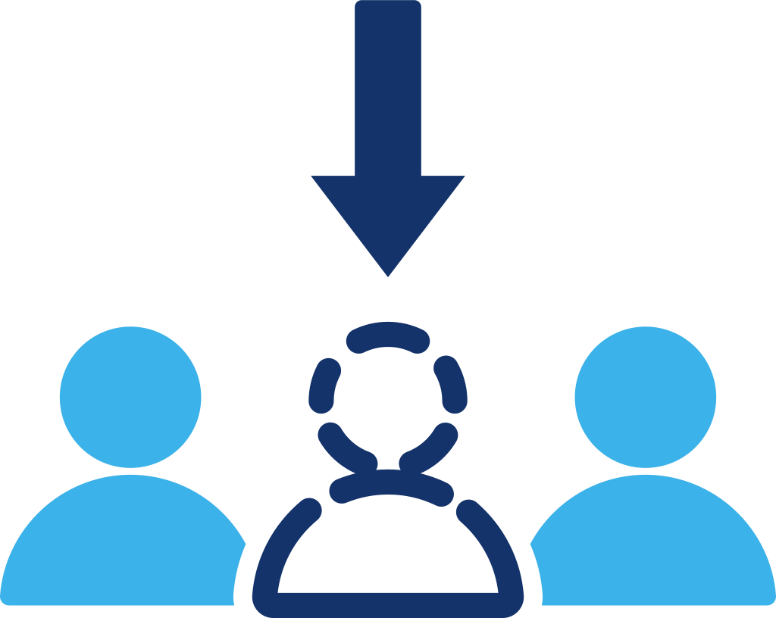
Telecom Insights
Predicting Churn, Preserving Value
Advanced Machine Learning and Explainable AI for Telecom Retention Strategies
PRESENTED BY
Audrey Chang
Notes:
Good afternoon. My name is Audrey Chang, and today I will present my research on ‘Predicting Churn, Preserving Value.’ I will demonstrate how I used advanced machine learning techniques, including Deep Learning and Stacking, to build a telecom churn prediction system that is not only accurate but also business-ready.

Slide 2

Table of Contents
Motivation
Setup
Models
Results
Insights
Wrap-up
Notes:
Here is today’s agenda. I will start with the motivation, walk you through the data setup and modeling process, and finally focus on the business insights and error analysis.

Slide 3

Problem and Research Questions
Problem: Telecom customer churn is costly; retention budgets are limited → need accurate and actionable risk ranking.
Goal: Build an end-to-end churn prediction pipeline under realistic constraints (class imbalance, leakage control, reproducibility)
ENGINEERING RIGOR
MODEL COMPARISON
EXPLAINABILITY IMPORTANCE
Leakage-controlled preprocessing, consistent train/val/test splits, and reproducible artifact logging (configs, models, metrics)
Benchmark a calibrated GLM baseline against tree/GBM models, deep tabular networks, and a stacking ensemble
Translate interpretable drivers and failure modes (SHAP + error analysis) into retention playbooks and budget-aware targeting
Motivation
Setup
Models
Results
Insights
Wrap-up
Notes:
Let’s start with the problem. In the telecom industry, acquiring a new customer is expensive. My goal was not just to train a model with high accuracy, but to build an end-to-end pipeline that solves three specific challenges:
Engineering Rigor: Preventing data leakage and ensuring reproducibility.
Model Comparison: Benchmarking simple baselines against complex Stacking and Deep Learning models.
Explainability: Translating ‘black-box’ predictions into actionable retention strategies.

Slide 4
Data & Evaluation
Dataset: telecom churn dataset (tabular, mixed numeric + categorical, imbalanced target)
Target: binary churn label (Churn01)
Split strategy: train/validation/test split done before any threshold learning / encoding fitting
Leakage control: exclude post-treatment / retention-intervention signals (e.g., retention call/accept variables)
Evaluation focus: ranking + decision usefulness under imbalance
Motivation
Setup
Models
Results
Insights
Wrap-up
Notes:
For the data setup, I used a telecom dataset with imbalanced targets. A critical step here was Leakage Control. I strictly excluded post-event features—like ‘retention calls’—which would give the model the answer cheat sheet. I also used a time-series-like split strategy to ensure we are predicting the future, not memorizing the past.

Slide 5
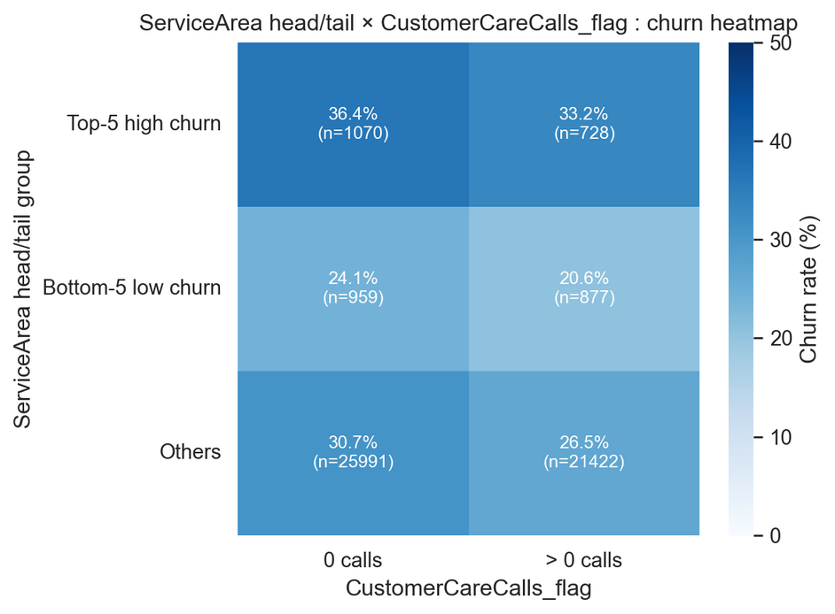
Feature Engineering
(Business-friendly + Leakage-safe)
Design principle: make features interpretable and stable; avoid high-cardinality explosion
Examples of engineered features (and why):
CustomerCareCalls_flag = support/complaint signal (actionable)
DroppedQuality_flag / DroppedBlockedCalls = network quality proxy
HighUsage_flag = usage pressure (threshold learned on train)
HandsetPrice_q = price binning + missing as category (robust)
HighRiskServiceArea_flag = compress high-cardinality area into risk flag
Motivation
Setup
Models
Results
Insights
Wrap-up

Slide 6
Models Compared
Four Families
Baseline: Logistic Regression (interpretable, strong calibration baseline)
Tree/GBM: Decision Tree, RandomForest, LightGBM, XGBoost (nonlinear + interactions)
Deep Learning: Dense MLP, Embedding NN, Wide & Deep; imbalance strategies (strong weighting, focal loss)
Ensemble: OOF Stacking over diverse base learners
Motivation
Setup
Models
Results
Insights
Wrap-up
Notes:
I experimented with three levels of model complexity:
1.Baseline: Logistic Regression for interpretability.
2.Tree-Based: XGBoost and LightGBM, optimized with Optuna for hyperparameter tuning.
3. Deep Learning: A Wide & Deep network using PyTorch.
Finally, I combined these into a Stacking Ensemble, which uses a Meta-Learner to learn the best weights from all base models.

Slide 7
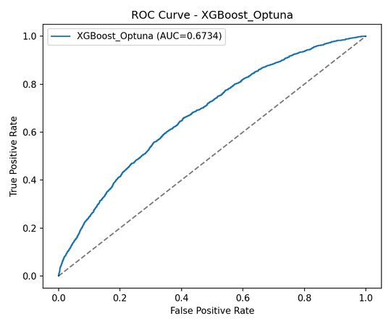
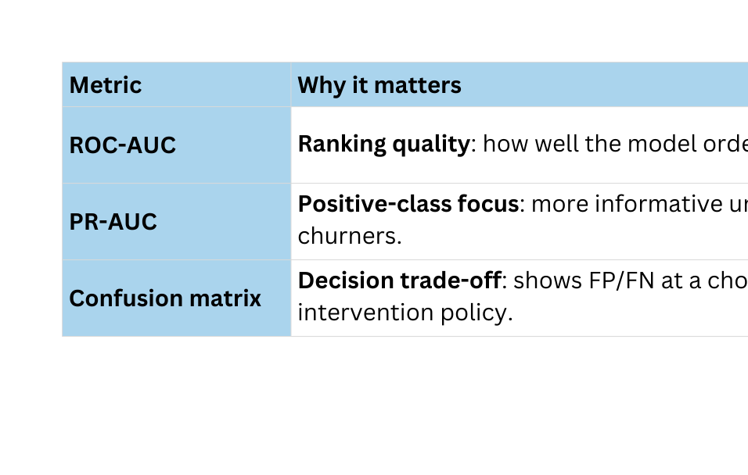
Experimental Design & Metrics
How I Compare Fairly
Same train/val/test split across all models
Hyperparameter tuning limited to validation (no test peeking)
Primary metrics: ROC-AUC and PR-AUC (imbalance-aware)
Decision metrics: F1 / Recall at tuned threshold; and threshold is chosen on validation
Motivation
Setup
Models
Results
Insights
Wrap-up
Notes:
On this slide, I’m explaining how I made the model comparison fair and decision-relevant.
First, all models use the exact same train/validation/test split, so any performance differences come from the model choice, not from different data.
Second, hyperparameter tuning is restricted to the validation set. I never use the test set to pick parameters or thresholds—so there is no test peeking. The test set is only used once, at the very end, for reporting.
For evaluation, I separate ranking metrics from decision metrics.
My primary metrics are ROC-AUC and PR-AUC.
ROC-AUC measures overall ranking quality across thresholds: how well the model orders churners above non-churners.
PR-AUC is more informative under class imbalance because it focuses on the positive class—churners—and reflects the precision-recall trade-off.
Then, for deployment decisions, I look at F1 and Recall at a tuned threshold. Importantly, the threshold is chosen on the validation set, not on the test set, because threshold selection is part of model design.
Finally, I use the confusion matrix to make the trade-off explicit—how many false positives and false negatives we get at that operating point—because those map directly to business costs and the retention policy.
So overall, this design makes results both comparable academically and actionable for business decisioning.”

Slide 8
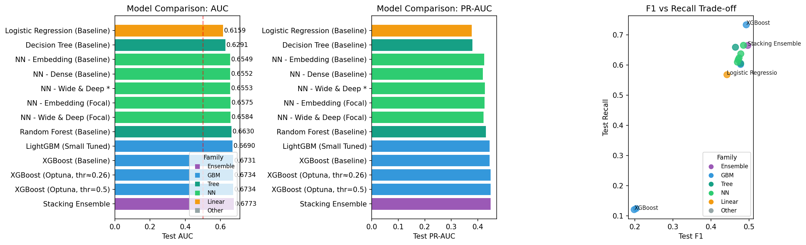
Main Results
Model Leaderboard
Leaderboard + Key Takeaway
Motivation
Setup
Models
Results
Insights
Wrap-up
Notes:
On this slide I’m summarizing the main leaderboard across all model families, evaluated on the same held-out test set.
Left: AUC.
The dashed red line is the random baseline at 0.5. My logistic regression baseline achieves about 0.616 AUC, and the simple decision tree is around 0.629.
Neural networks are competitive in the mid 0.65 range, but the best performance comes from tree-based boosting and ensembles: XGBoost is around 0.673, and the stacking ensemble is the top model at about 0.677 AUC. So overall, compared with the GLM baseline, the best model improves AUC by roughly +0.06.
Middle: PR-AUC.
Because churn is imbalanced, PR-AUC is more sensitive to how well we identify churners. The ranking is consistent: boosting and stacking remain strongest, and neural nets are close but not the top.
Right: F1 vs Recall trade-off.
This shows the operating point matters. At the default threshold, models can be too conservative and miss churners. When I tune the threshold, XGBoost reaches the highest recall (around 0.73) with F1 near 0.5, and the stacking model is close behind.
Key takeaway: under a realistic pipeline, boosting + ensembling gives the best lift, but the final deployment choice should be based on the business cost of false negatives, which is why I treat threshold selection as part of the evaluation.

Slide 9
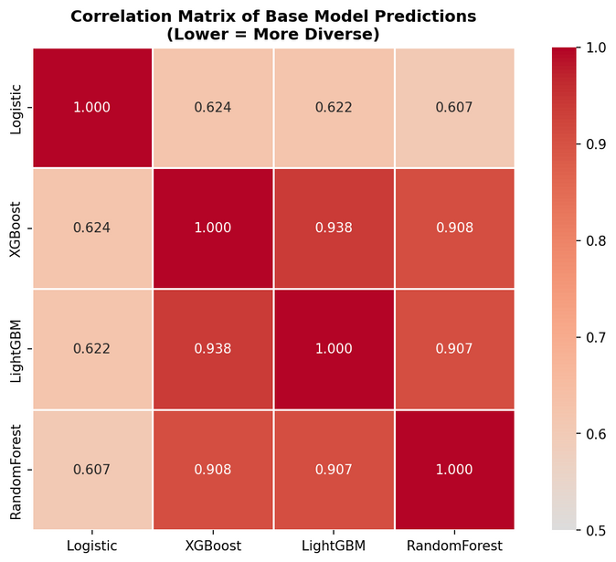
Advanced Modeling Beyond GBM
Tabular Deep Learning + Leakage-safe Stacking
Controlled study: 7 NN variants under the same data split + training protocol(dense / embedding / wide&deep / deeper / focal / weighting)
Best NN: Wide & Deep — Val AUC 0.6356, Test AUC 0.6553, PR-AUC 0.4259
Imbalance handling: used class-weighted BCE (pos_weight); compared with stronger weighting and focal loss ablations
Takeaway: Embeddings + wide component help, but gain is limited vs top GBMs on this tabular dataset
Why stacking: combine complementary errors across model families
Evidence of diversity: avg prediction correlation ≈ 0.768 (not identical signals)
Negative result: naïve averaging did not beat the best single model (important sanity check)
Leakage-safe method: meta-learner trained on out-of-fold (OOF) base predictions
Result: Stacking Test AUC 0.6773 vs best single XGB 0.6734 (+0.58% relative lift)
Motivation
Setup
Models
Results
Insights
Wrap-up
Notes:
After establishing GBM as a strong baseline, this slide covers what I tried beyond GBM: tabular deep learning and a leakage-safe stacking ensemble.
First, the tabular deep learning study.
I ran a controlled comparison of 7 neural network variants under the same train/validation split and the same training protocol—dense networks, entity embeddings, wide-and-deep, deeper versions, plus imbalance strategies like stronger class weighting and focal loss.
The best neural model was Wide & Deep, achieving about Val AUC 0.636 and Test AUC 0.655, with PR-AUC around 0.426. So embeddings and a wide component help, but on this dataset the gain is still limited compared with top boosting models.
Second, why stacking.
Even if GBMs are strongest, different model families can make different mistakes, so stacking can exploit complementary errors.
The heatmap on the right shows the correlation of base-model predictions. They’re not identical—average correlation is around 0.77—which is evidence there’s some diversity to combine.
Important sanity check:
A naive averaging ensemble did not beat the best single model, so stacking has to be done carefully.
Leakage-safe method:
To avoid leakage, I train the meta-learner only on out-of-fold (OOF) predictions from base models, then evaluate once on the untouched test set.
Result:
Stacking achieves Test AUC 0.6773, slightly above the best single XGBoost at 0.6734—about +0.58% relative lift.
So the takeaway is: deep learning is competitive and useful for feature learning, but the most reliable marginal improvement here comes from a carefully validated stacking ensemble, not from naive ensembling.

Slide 10
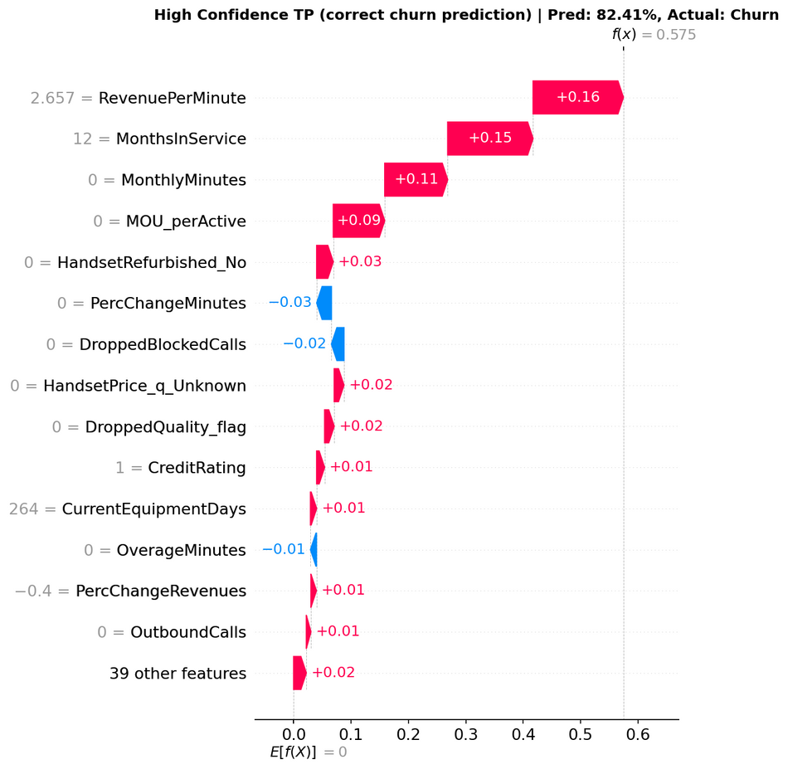
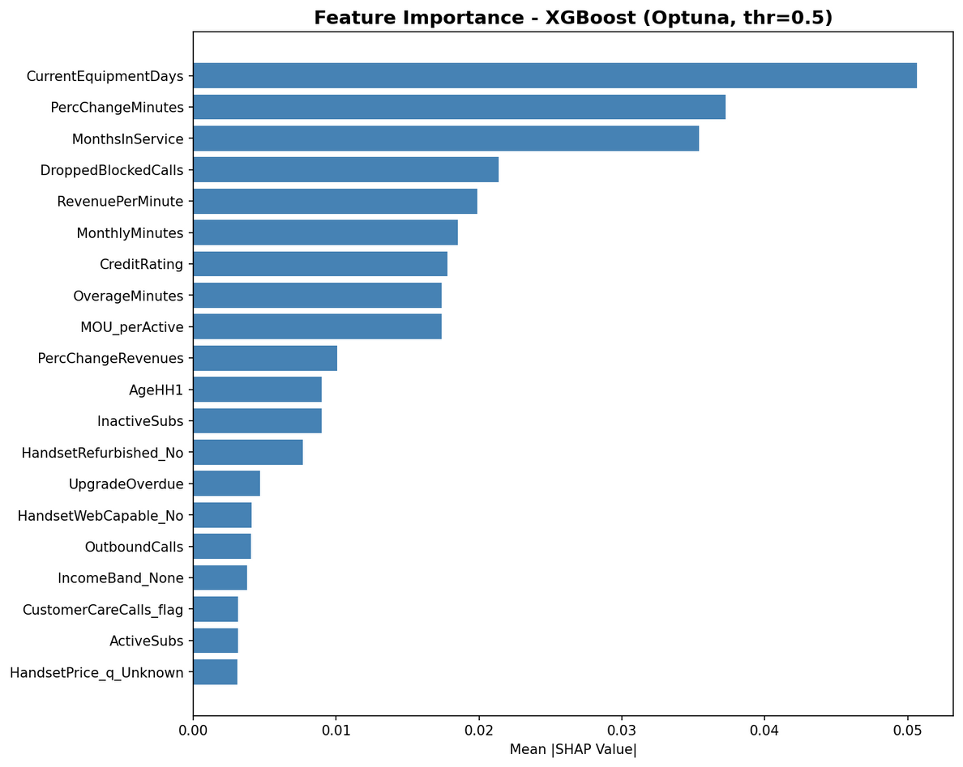
Explainability: SHAP Insights
From “Black Box” to Action
Global SHAP shows top churn drivers: CurrentEquipmentDays (largest), PercChangeMinutes, MonthsInService, DroppedBlockedCalls, RevenuePerMinute, MonthlyMinutes, etc
Use SHAP dependence plots to show nonlinear risk patterns (e.g., device age / usage change effects)
SHAP is associational, not causal → interventions should be validated with experiments
Motivation
Setup
Models
Results
Insights
Wrap-up
Notes:
Now I move from model performance to explainability. In a business setting, a ‘black box’ prediction isn’t enough — stakeholders need to know why a customer is likely to churn.
First, global SHAP.
The global SHAP ranking shows the top churn drivers. The largest driver is CurrentEquipmentDays, then PercChangeMinutes and MonthsInService, followed by operational and value signals like DroppedBlockedCalls, RevenuePerMinute, and MonthlyMinutes.
So overall, churn risk is strongly associated with device lifecycle, behavior change, and service/price friction.
Click
Second, local SHAP for one customer.
On the right, the waterfall explains a high-confidence true positive where the model predicts 82% churn. The biggest factors pushing risk up are RevenuePerMinute (+0.16), MonthsInService (+0.15), and very low MonthlyMinutes (+0.11), plus usage efficiency MOU_perActive (+0.09). A few factors reduce risk slightly, but they’re too small to offset the main drivers, so the final prediction stays high.
Finally, I want to emphasize: SHAP is associational, not causal, so if we design interventions like plan adjustment or upgrade offers, we should validate impact with experiments.”

Slide 11

Business Case Study
Why calibrated probabilities matter
Decision rule (expected value):
Expected Loss = P(churn) × LTV
Retain only if: P(churn) × LTV > Cost(retention)
Example assumption:
Cost = $200, LTV = $1000 → break-even probability = 0.20
Why calibration matters:
If model says 0.80 but true churn rate is 0.10, you over-spend and get negative ROI (you’re “buying insurance” that’s too expensive).
Motivation
Setup
Models
Results
Insights
Wrap-up
Notes:
Now, let’s talk about business impact. High AUC is good, but ROI is what matters. I defined a decision rule based on Expected Loss. We should only offer a retention incentive if the Probability of Churn times LTV is greater than the Retention Cost.
For example, if the retention cost is $200 and LTV is $1000, our break-even probability is 0.20. This proves why Calibration is key. If a model is uncalibrated and over-predicts risk (e.g., saying 0.8 when it's actually 0.1), we waste money on customers who weren’t going to leave. My model ensures these probabilities are usable for this financial formula.

Slide 12
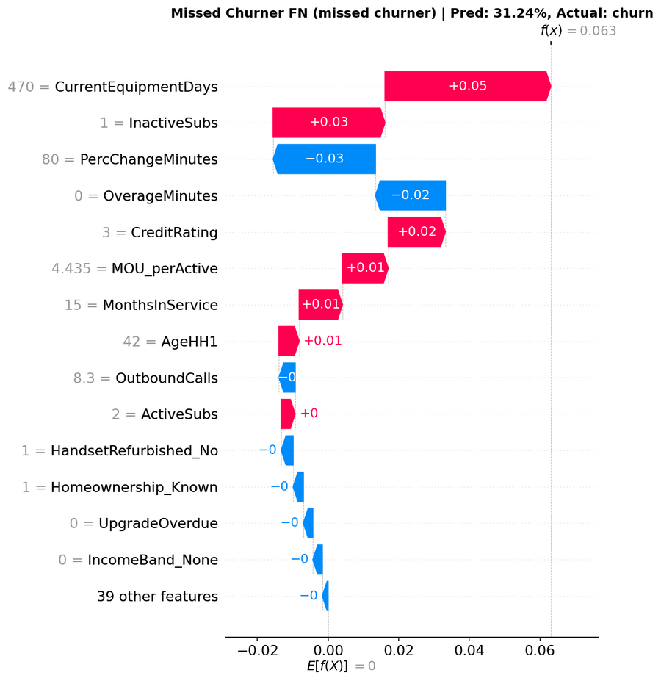
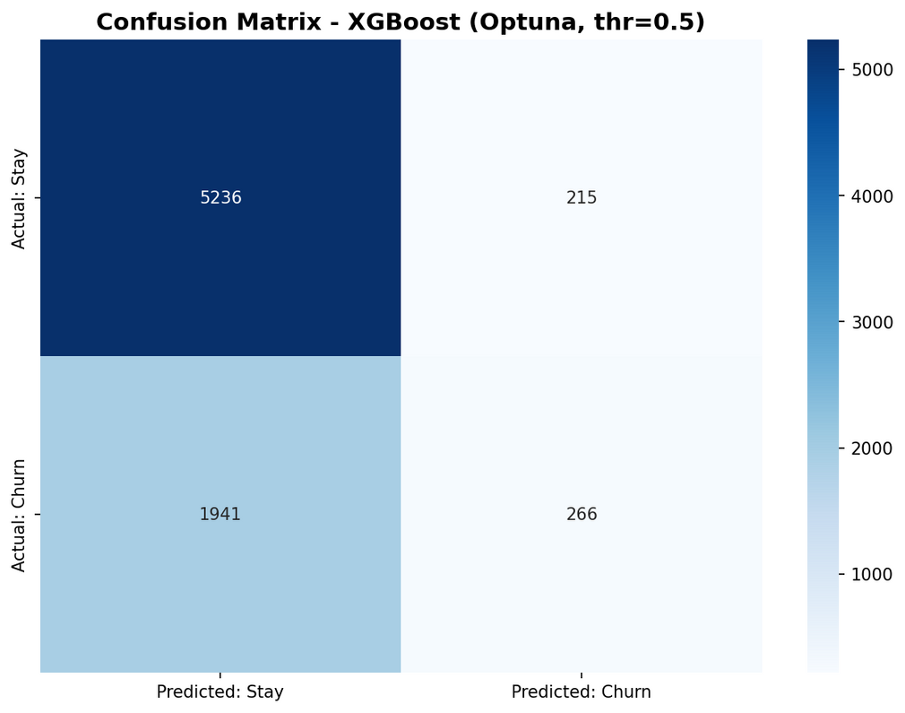
Error Analysis & Decisioning
Threshold + Confusion Matrix + Next Steps
Default threshold 0.5 can miss churners (example confusion matrix shows churn recall is low at 0.5)
In my paper-style evaluation, I also tune threshold to hit business goals (e.g., threshold ≈ 0.2577 giving churn recall ≈ 0.734)
Show one FN SHAP waterfall: competing signals + threshold too high→ action: adjust threshold, add features, or segment strategy
Next steps: calibration check, uplift testing, monitoring drift by key driver
Motivation
Setup
Models
Results
Insights
Wrap-up
Notes:
Finally, I performed an error analysis to 'close the loop' between modeling and decision-making. If we used the default 0.5 threshold, we would miss too many churners. By tuning the threshold down to 0.26 based on the business cost I just mentioned, looking at this Confusion Matrix, we successfully boosted the Recall to 73%. This means we are catching the majority of at-risk customers.
However, no model is perfect. Here is a specific False Negative case—a customer who churned, but the model predicted 'Stay'.
The SHAP Waterfall reveals a classic case of 'Competing Signals'. Please look at the top feature: CurrentEquipmentDays. It is a large Red bar. This means the model did detect the risk coming from the customer's old device. It knew this was a danger sign.
But, look at the Blue bars below it. Other features (like their long history or payment patterns) acted as strong 'safety signals' that counteracted the risk, pulling the final score down below our threshold.
This tells me that to fix these 'tie-breaker' cases, I need to engineer 'Trend Features'. We need to capture recent behavior changes (like a sudden drop in usage) to help the model realize that the Red risk signal should have outweighed the Blue ones.

Slide 13
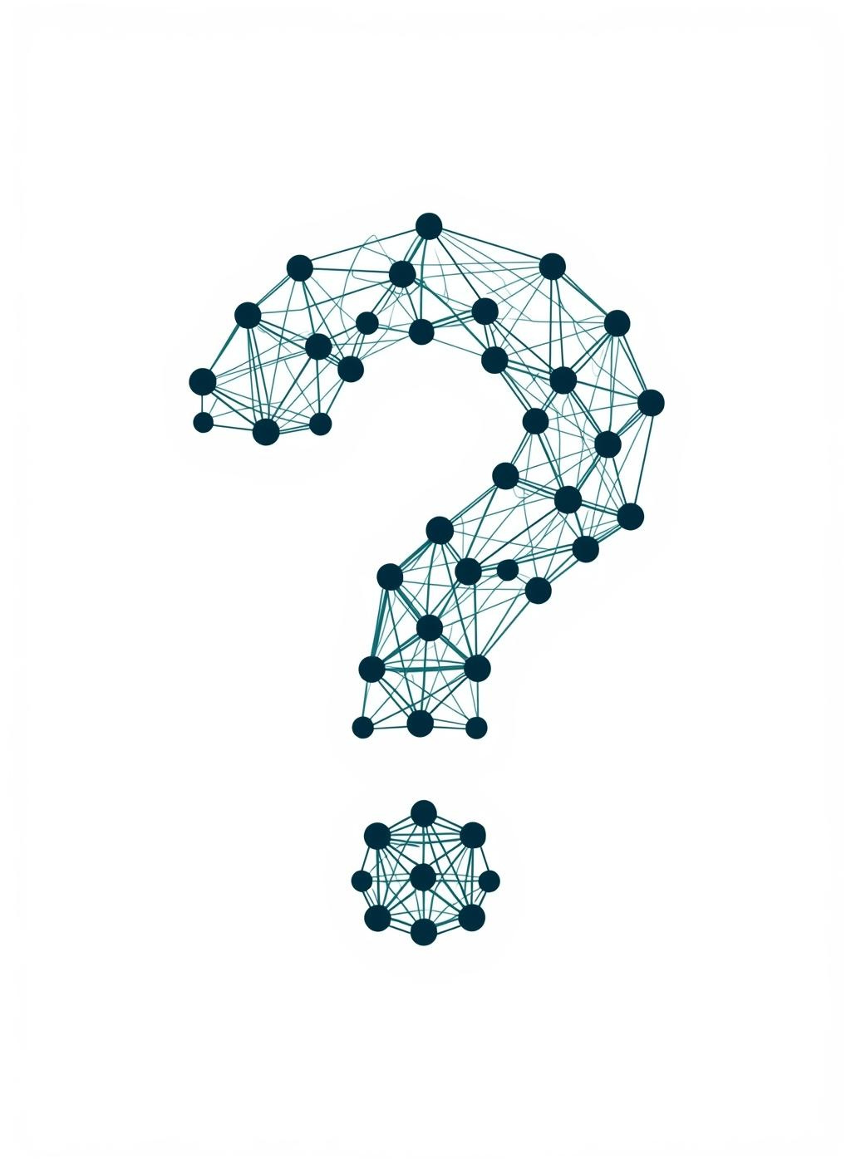
Q&A
Motivation
Setup
Models
Results
Insights
Wrap-up
Notes:
To conclude, this project delivered:
A rigorous, leakage-free pipeline.
A Stacking model that outperforms single baselines.
And most importantly, a business-aligned decision framework that balances accuracy with financial ROI. Thank you for your time. I am now open to questions.

Slide 14
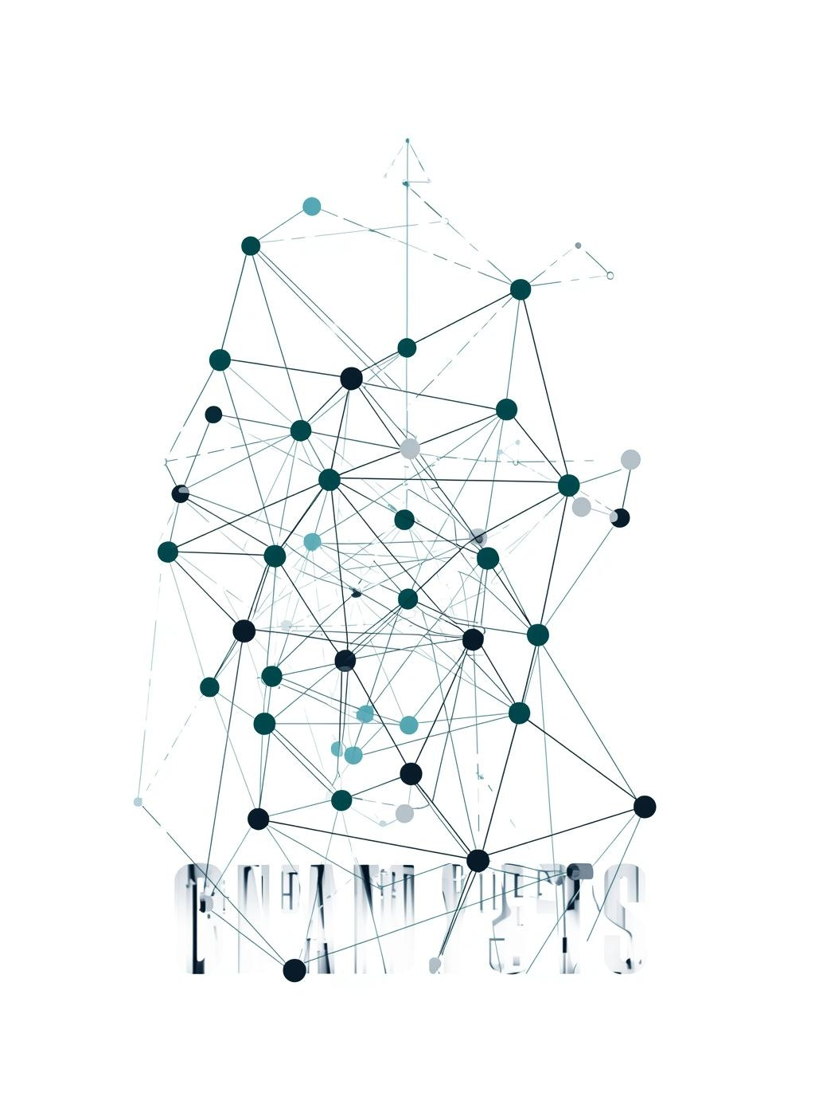
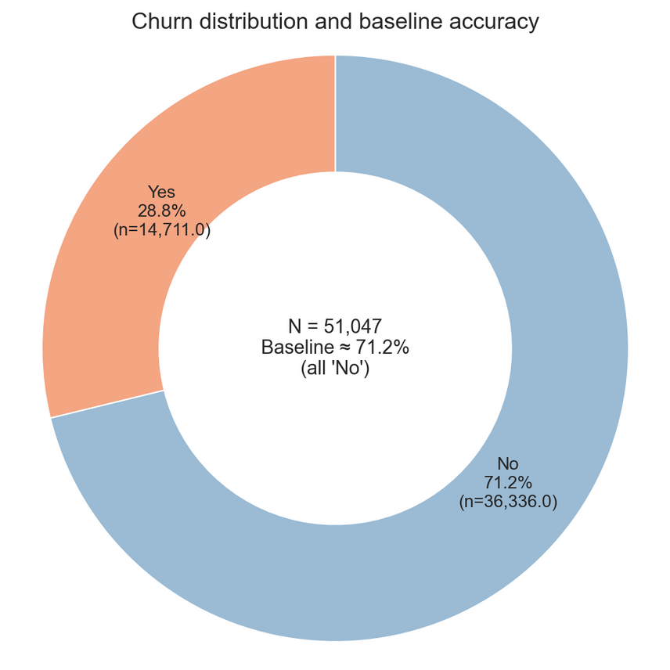
Backup Slide Menu
Motivation
Setup
Models
Results
Insights
Wrap-up

Slide 15
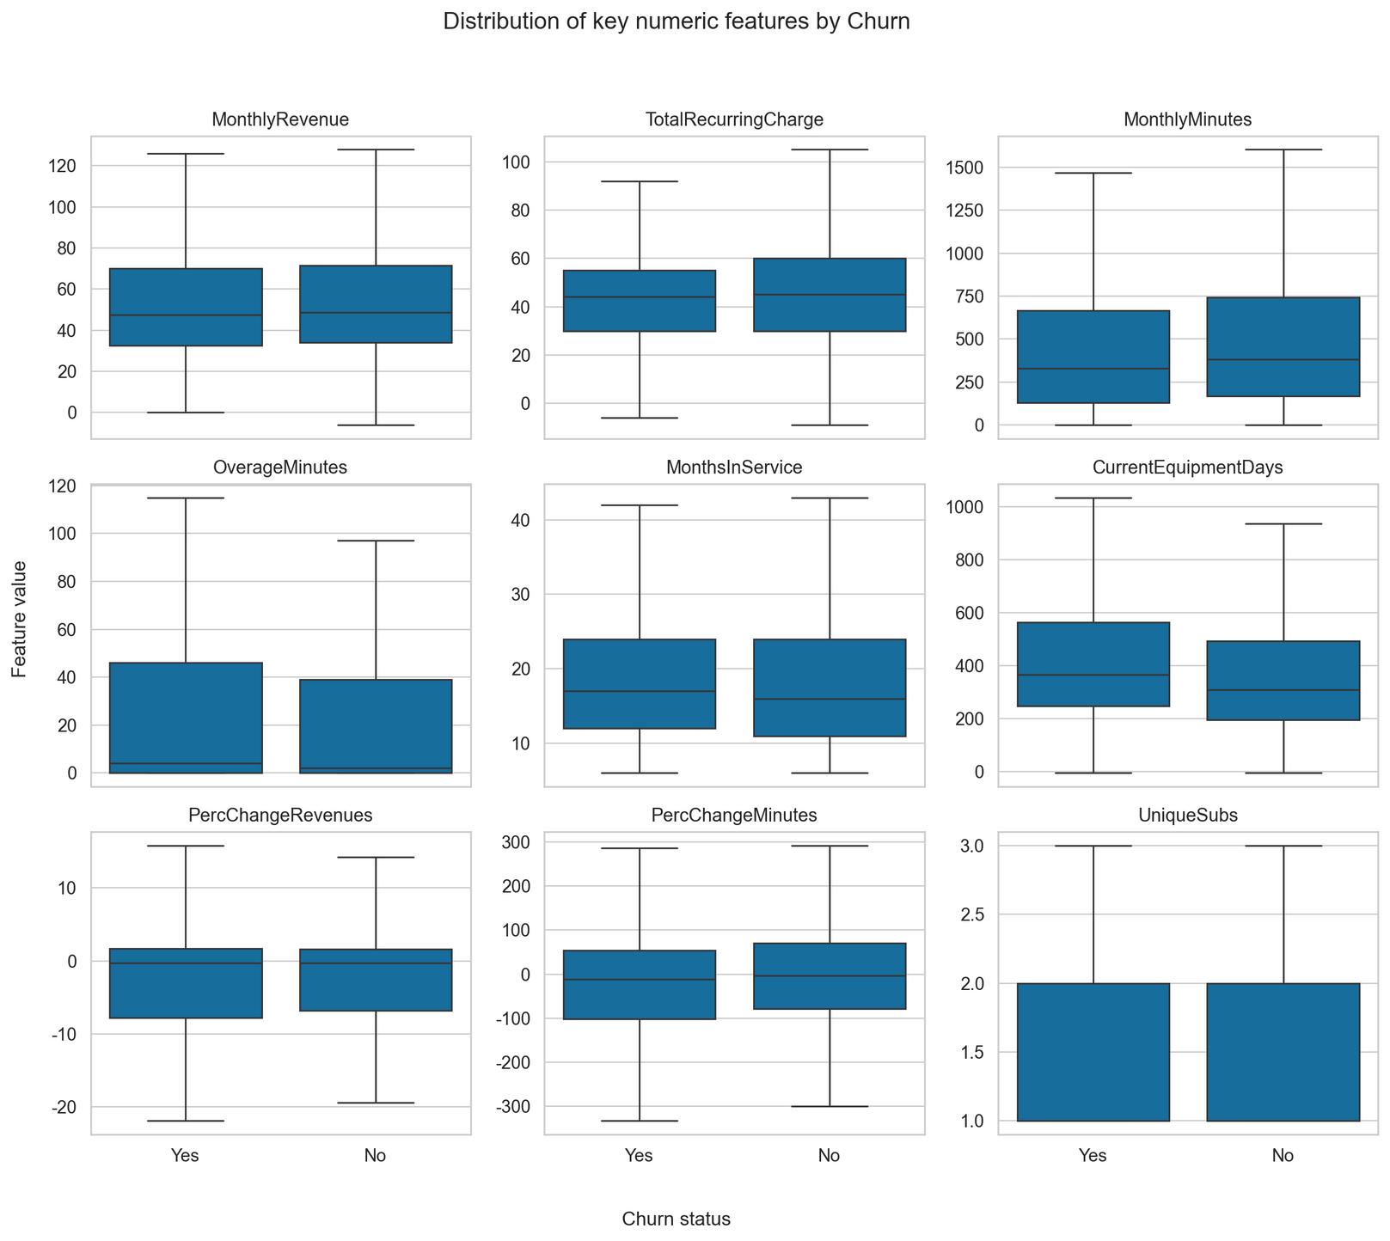

Slide 16
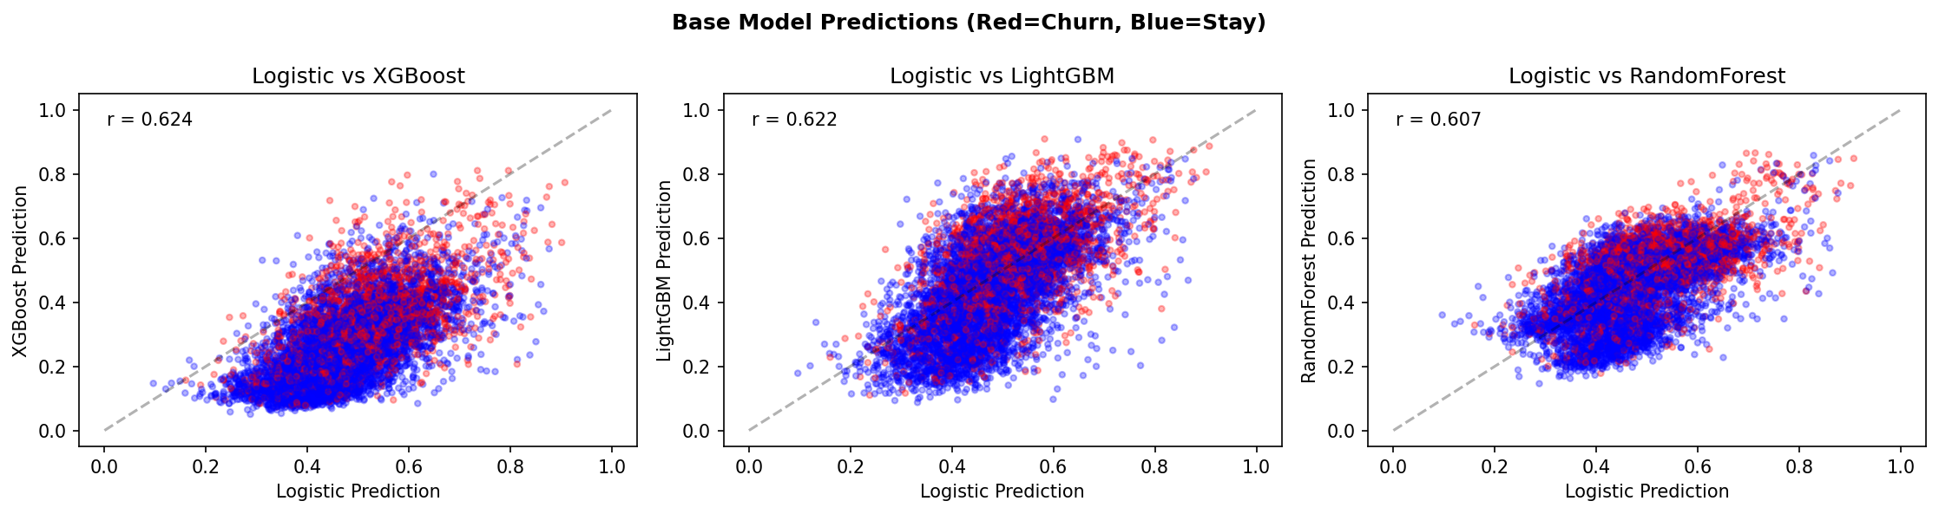

Slide 17
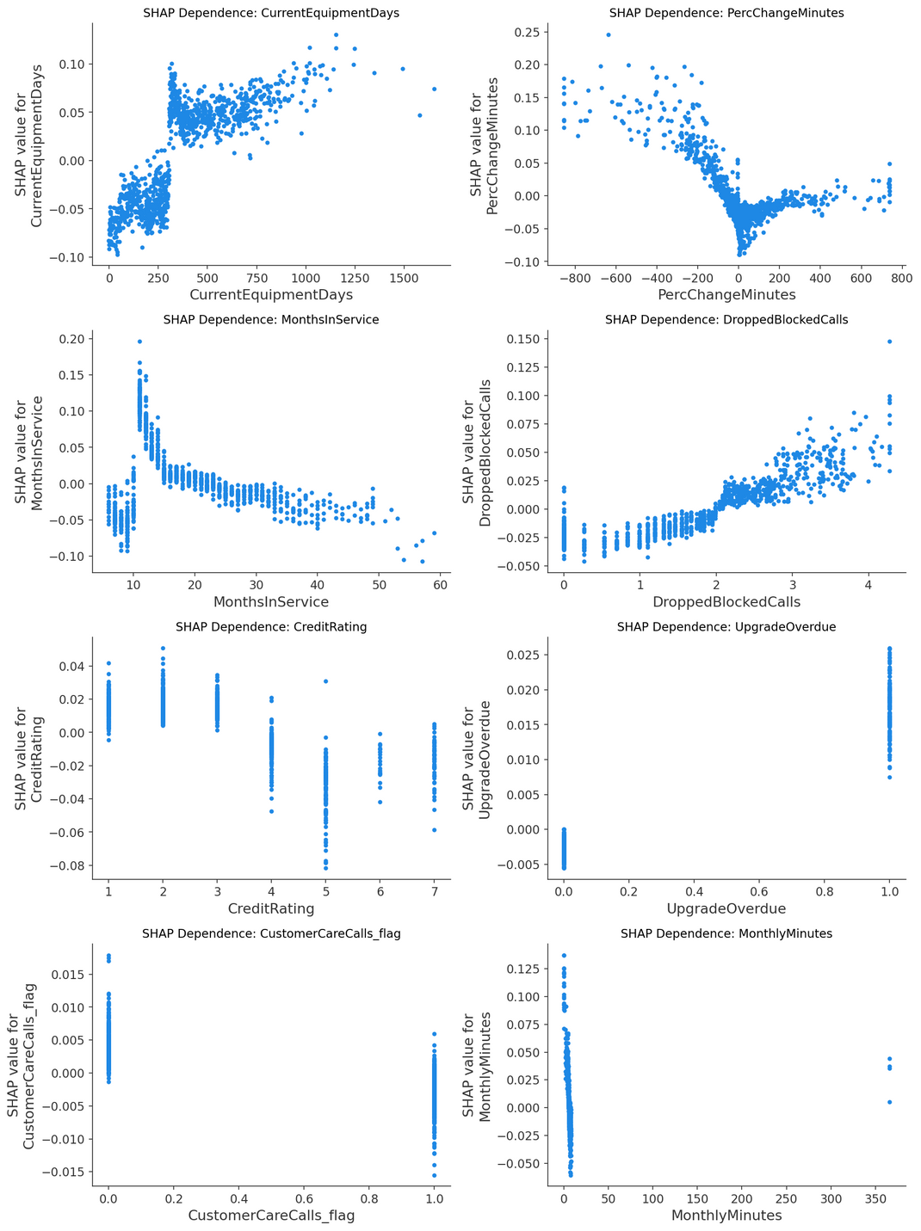

Slide 18
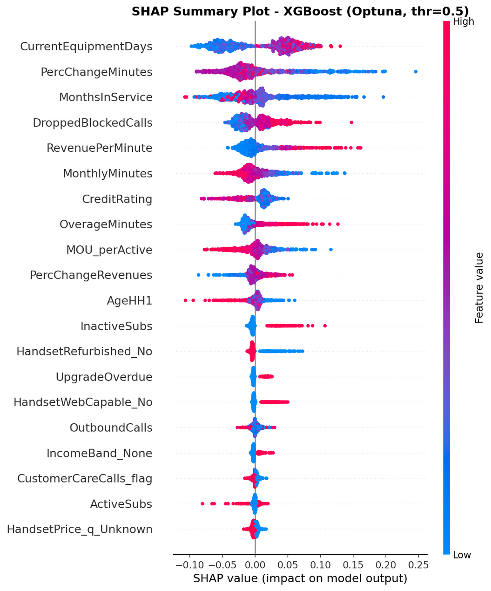

Slide 19
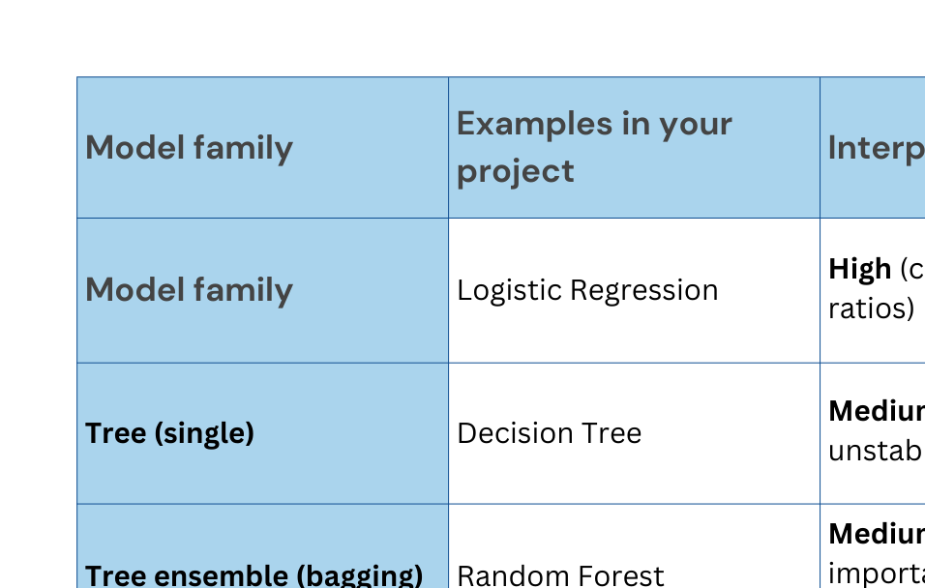

Slide 20
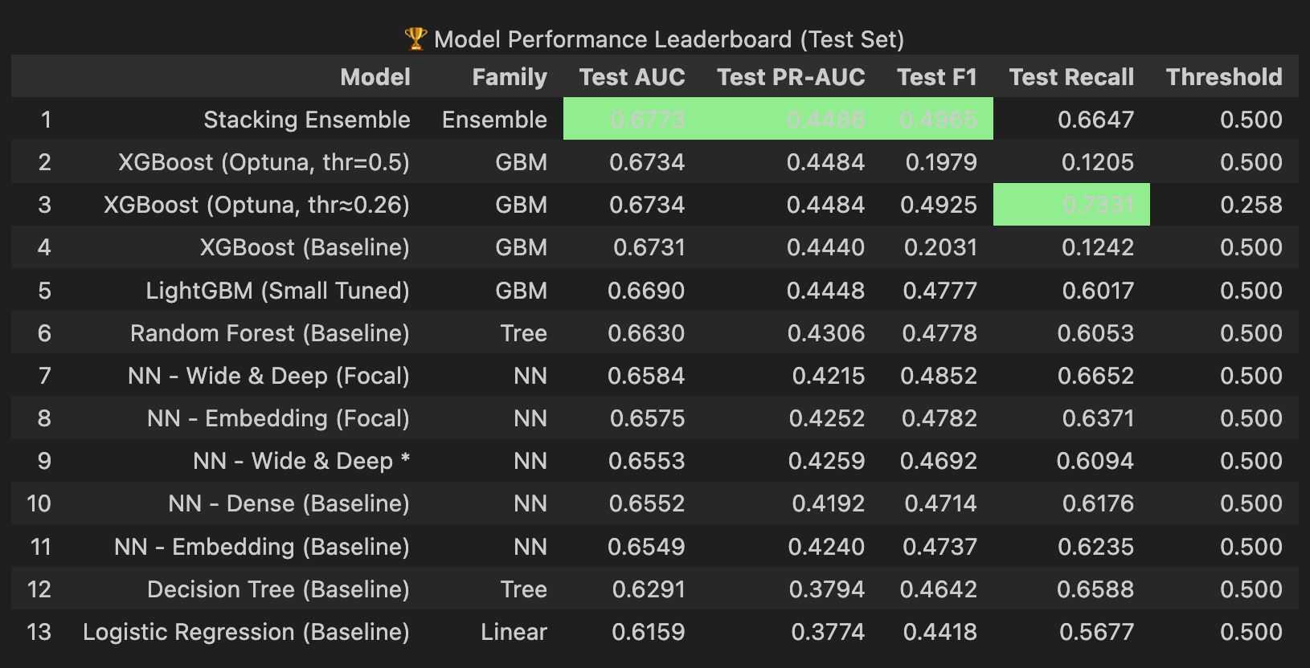

Slide 21
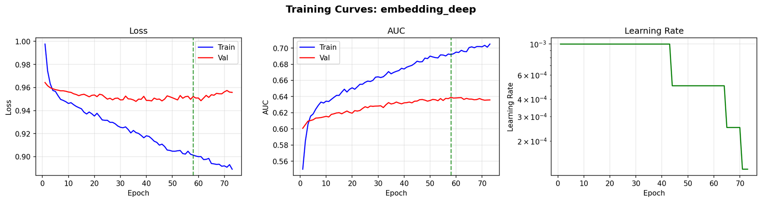
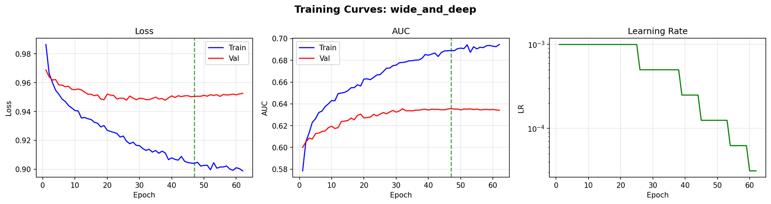

Slide 22
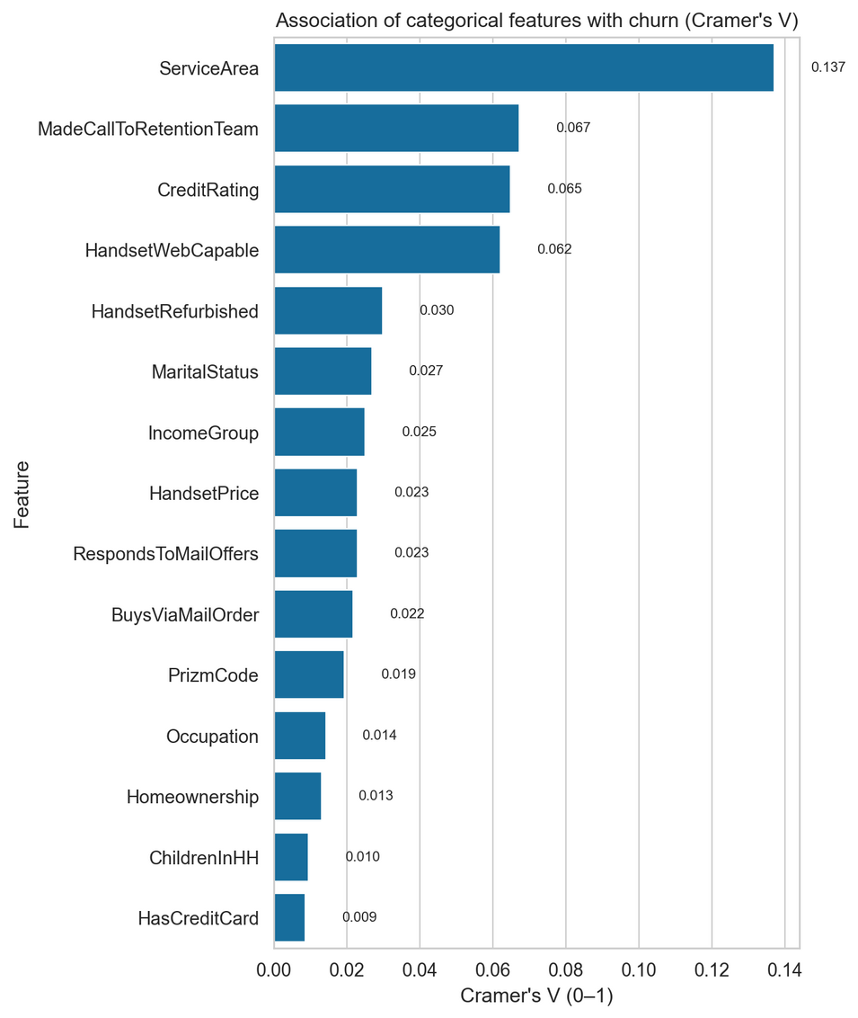
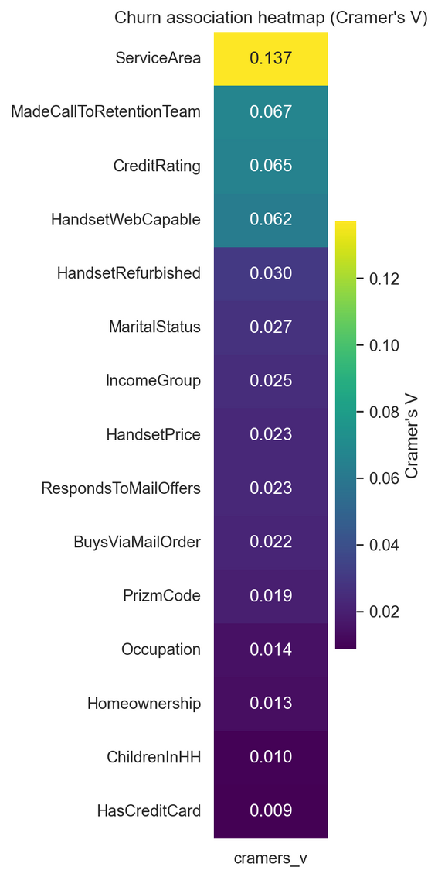

Slide 23
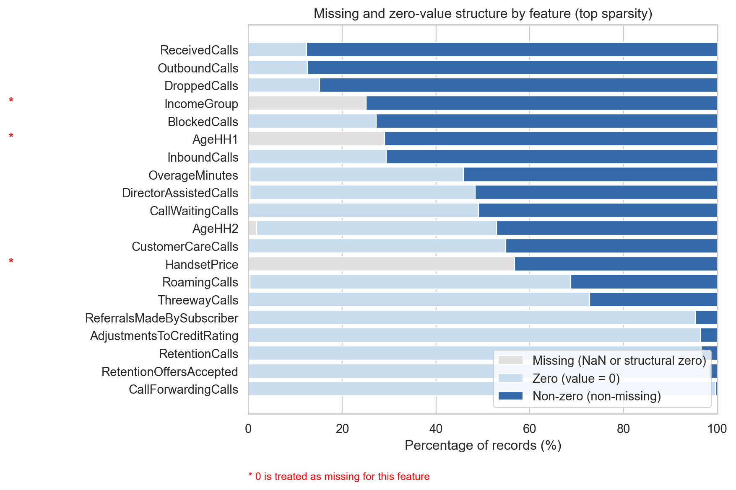

Slide 24
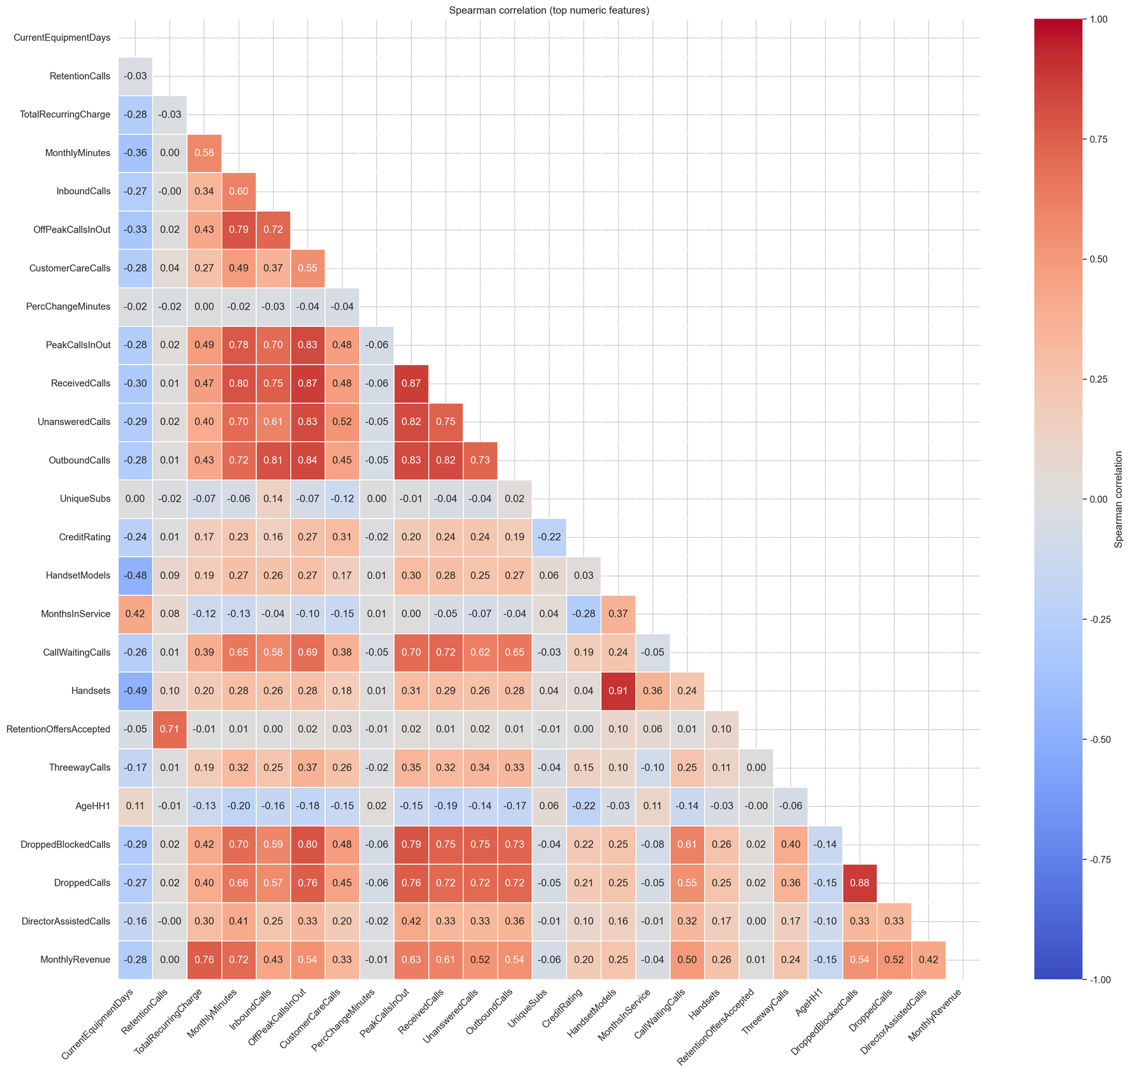

Slide 25
